Slide 1
Multimodal Sarcasm Detection
Team Members
Sai Sree Yoshitha Akunuri
Shreya Venkatesh Prabhu

Slide 2
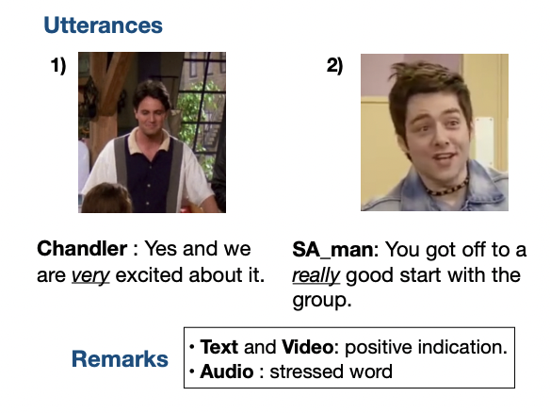

Problem Statement
Sarcasm can sometimes be detected with just the text, while other times we might need additional information like context, vocal stress, facial expressions, etc.
It is therefore important to use multiple modalities to detect sarcasm.
Image Reference [1]
Image Reference [2]

Slide 3
Literature Survey
Santiago Castro, Devamanyu Hazarika, Verónica Pérez-Rosas, Roger Zimmermann, Rada Mihalcea, and Soujanya Poria. 2019. Towards Multimodal Sarcasm Detection (An _Obviously_ Perfect Paper). In Proceedings of the 57th Annual Meeting of the Association for Computational Linguistics, pages 4619–4629, Florence, Italy. Association for Computational Linguistics.
Anupama Ray, Shubham Mishra, Apoorva Nunna, Pushpak Bhattacharyya (2022) A multimodal corpus for emotion recognition in sarcasm, arXiv.org. Available at: https://arxiv.org/abs/2206.02119

Slide 4
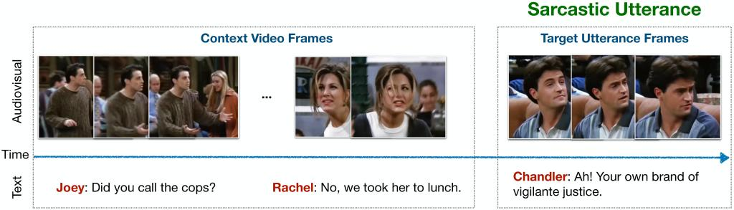
Dataset - MUStARD++
MUStARD++ is a multimodal dataset consists of videos and transcripts from sitcoms like Big Bang Theory, Friends etc
There are 1202 instances (context + utterance) out of which 601 are sarcastic and 601 are non-sarcastic.
Image Reference [1]
Notes:
Balanced dataset
Two parts - context and target utterance with speaker info
Aim to classify

Slide 5
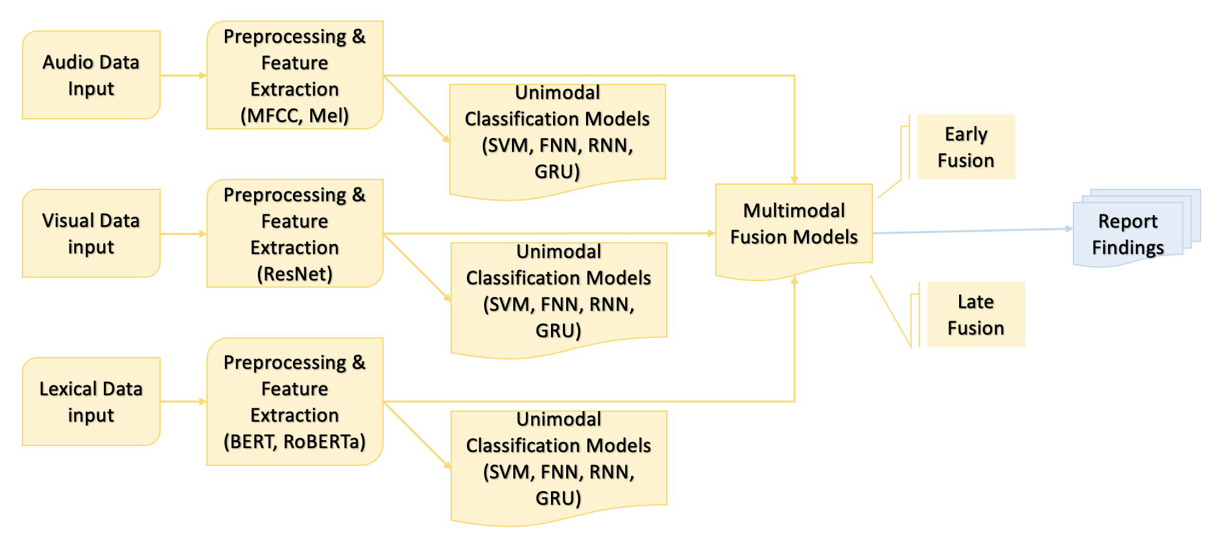
Planned Method
Notes:
Proposed plan
Unimodal and Multimodal fusion models
Experiments - Presence and absence

Slide 6
Preprocessing & Feature Extraction
Visual:
Preprocessing steps:
Keyframe extraction: 15 keyframes are extracted from each video sample.
All keyframes are resized, center cropped and normalized.
Feature Extraction:
ResNet50 features are extracted
Global average pooling per frame is done on the extracted features
Feature dimension: (T x 2048), where T is number of keyframes

Slide 7
Preprocessing & Feature Extraction
Audio(Librosa):
Preprocessing steps:
22050 Hz sampling rate, frames of 93ms spaced by 23ms.
Background noise was removed.
Feature Extraction:
Low level features such as MFCC, Mel spectrogram, spectral centroid, zero cross rate, tone and their associated temporal derivatives(delta) were extracted
Feature dimension (T x 690) where T is number of frames
Audio(TRILL):
Preprocessing steps:
16000Hz sampling rate
Background noise was removed.
Feature Extraction:
A Resnet triplet-loss model trained on AudioSet. We access this model from TensorFlow Hub
Log Mel spectrogram was extracted frame wise
Feature dimension (1 x 1024)

Slide 8
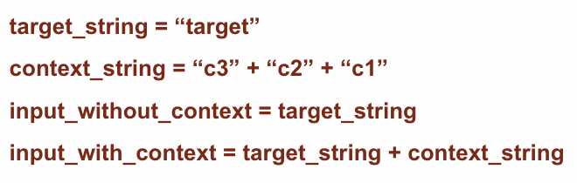
Preprocessing & Feature Extraction
Lexical
Preprocessing steps:
Removing html tags, urls, non alphabetical characters, extra spaces and replacing contractions
Concatenated the ’context’ in reverse order of timestamp.
Feature Extraction:
Embeddings were generated using
bert-base-uncased (BERT)
bert-base-uncased-emotion (BERT Emotion)
roberta-base (RoBERTa)
emotion-english-distilroberta-base (RoBERTa Emotion)
Single sentence classification task
Final embeddings obtained is average of the last four transformer layer representations and has dimension of 512 x 768

Slide 9
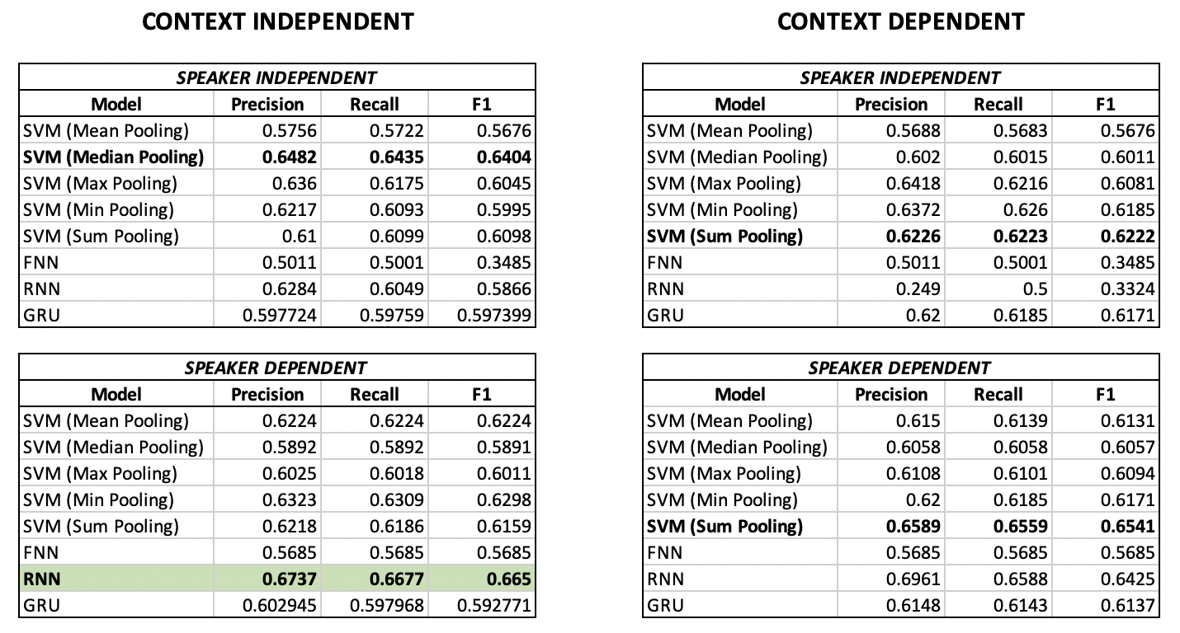
Results - Visual Modality

Slide 10
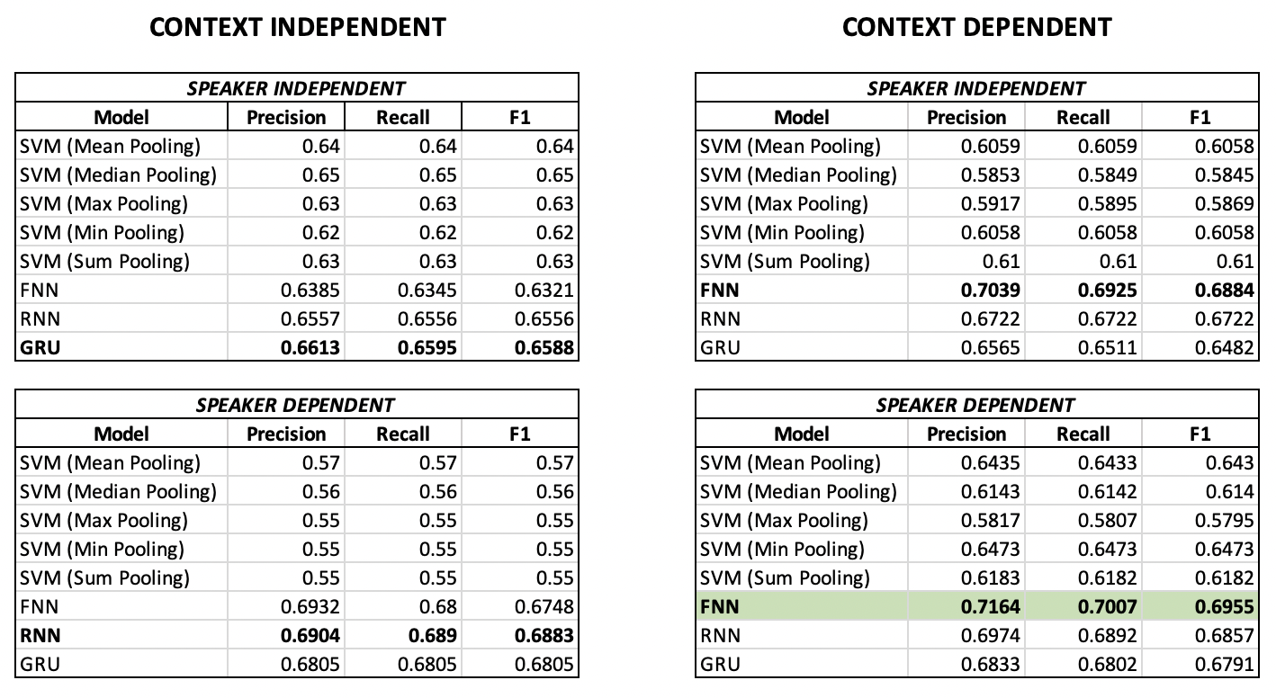
Results - Audio Modality (Librosa)

Slide 11
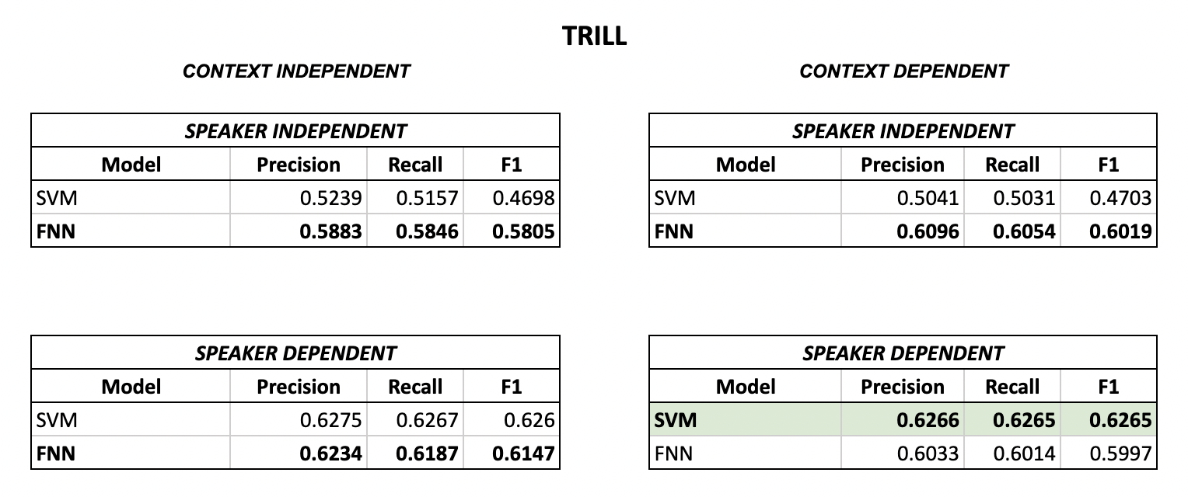
Results - Audio Modality (TRILL)

Slide 12
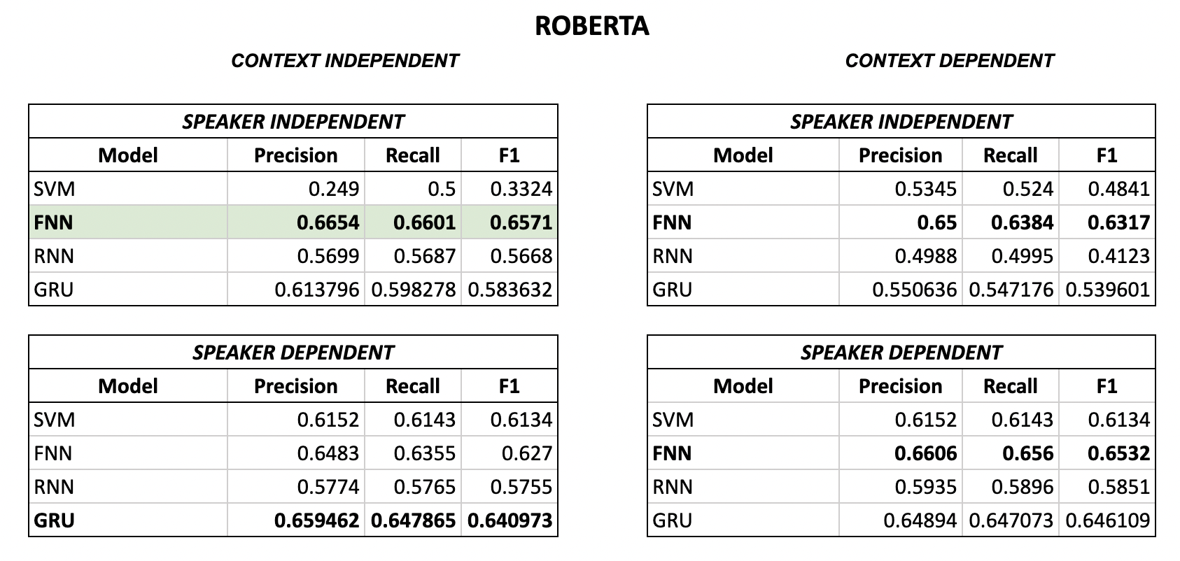
Results - Lexical Modality

Slide 13
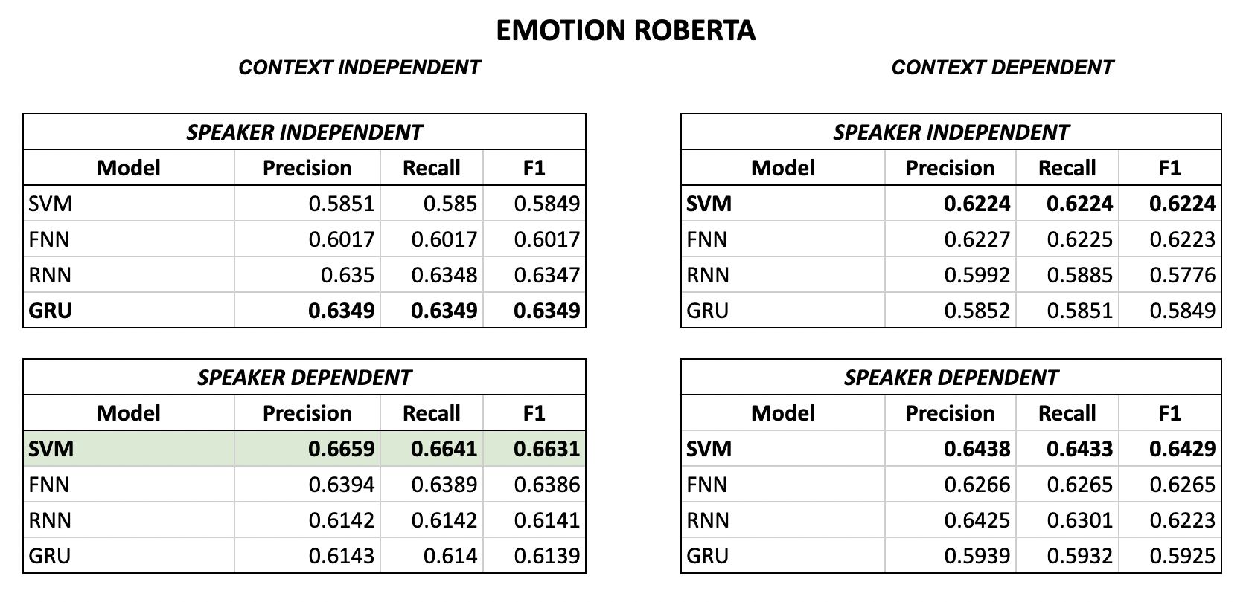
Results - Lexical Modality

Slide 14
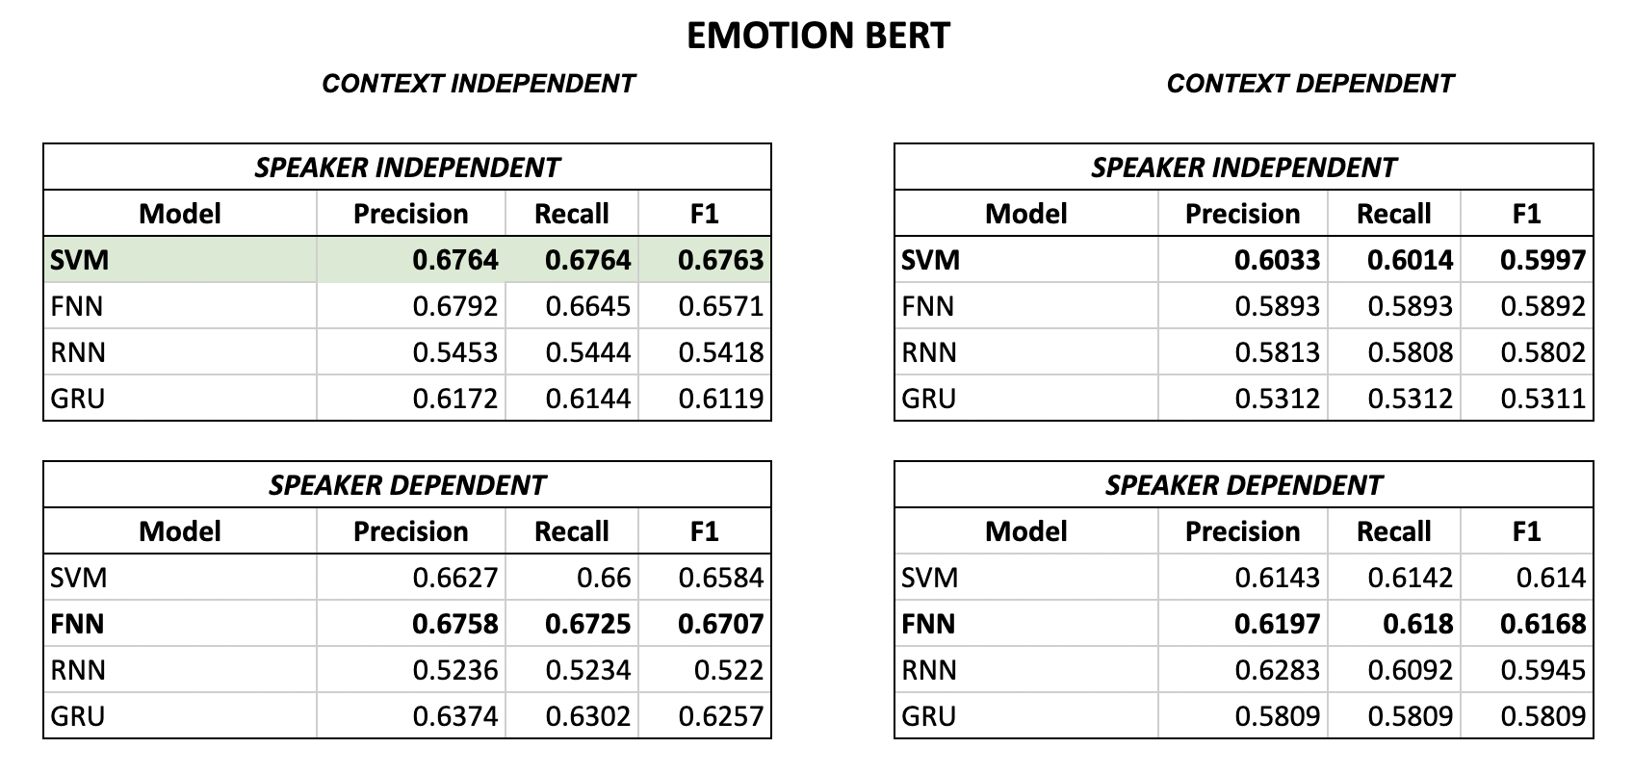
Results - Lexical Modality

Slide 15
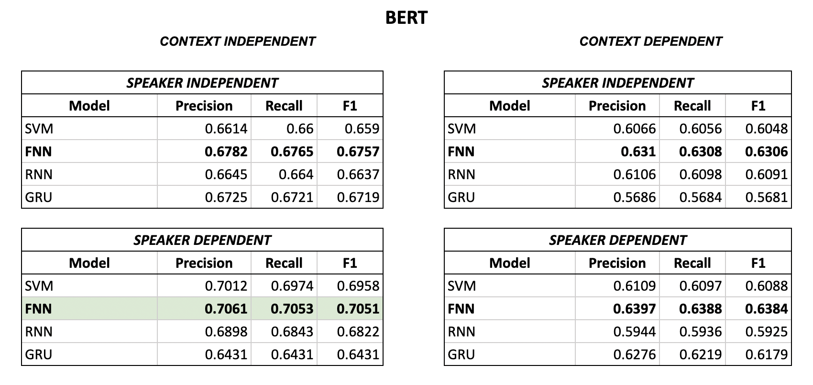
Results - Lexical Modality

Slide 16
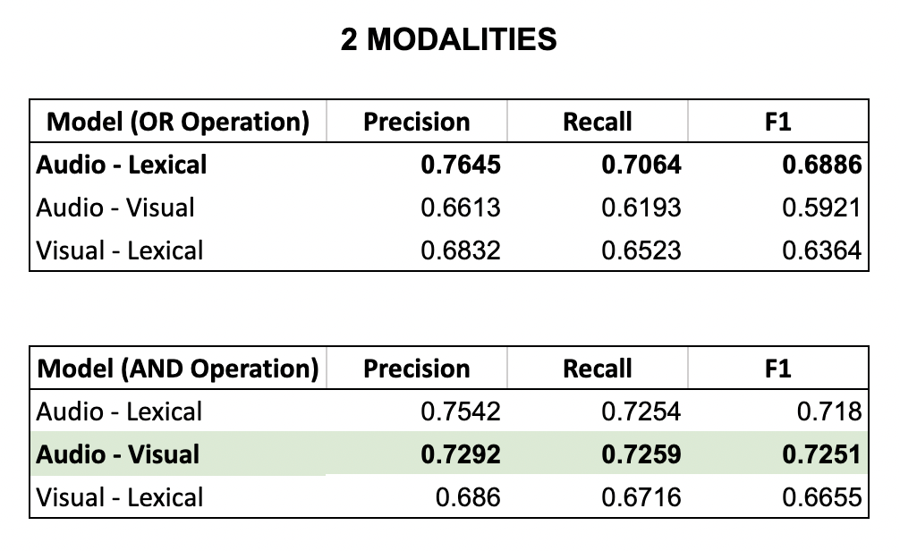
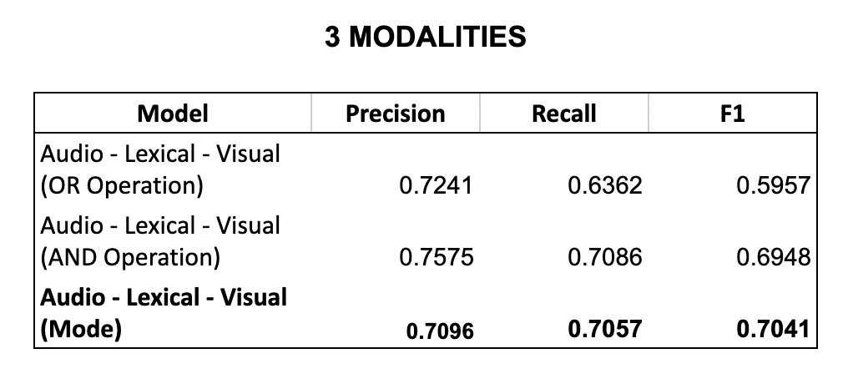
Results - Late Fusion
Audio model is with context and speaker information
Visual model is with speaker information
Lexical model is with speaker information

Slide 17
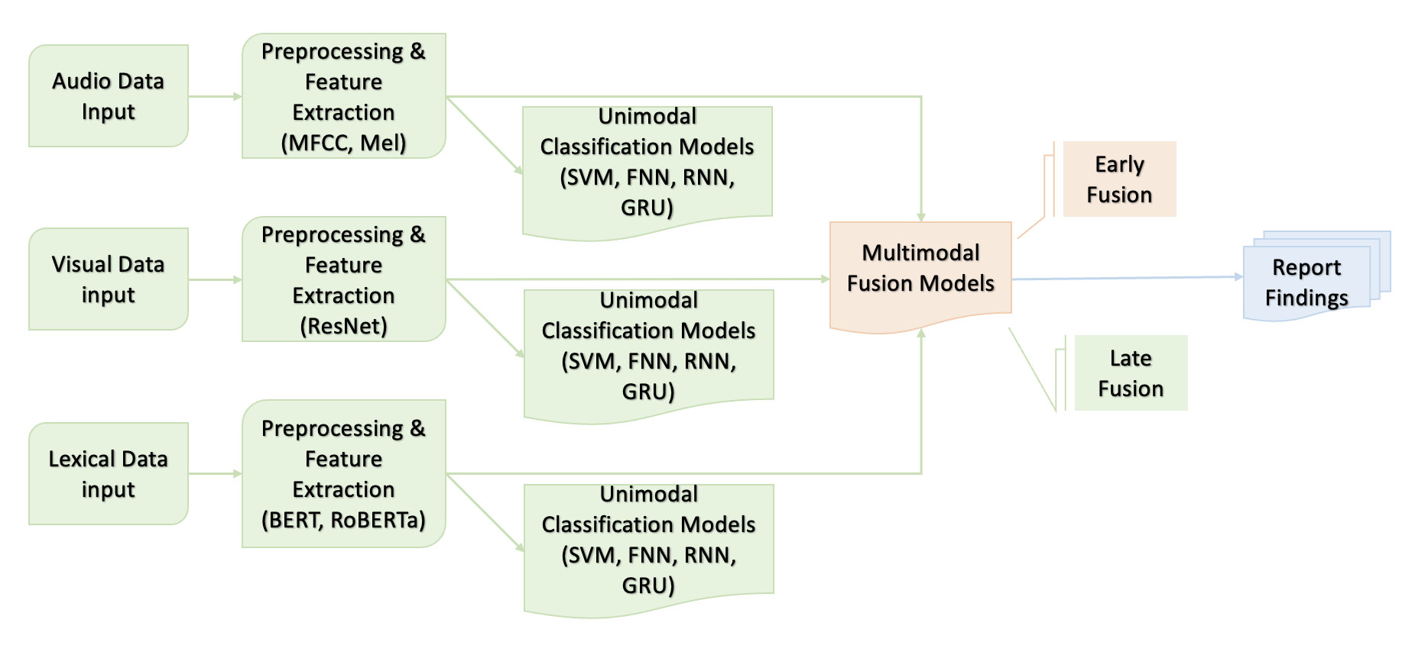
Planned Future Work
Notes:
In proposed plan, Audio and Video modality and unimodal models are completed.
Lexical - Bert and Roberta embeddings
Similar experiments - how much important are context info and speaker info in classification
Report findings with 2 modalities and 3 modalities

Slide 18
Team Member Contributions
Sai Sree Yoshitha Akunuri
Video Modality (ResNet) - Data preprocessing, Feature extraction, and related experiments
Text Modality (RoBERTa, Emotion RoBERTa, Emotion BERT) - Data preprocessing, Feature extraction, and related experiments
Late Fusion (2 Modalities)
Shreya Venkatesh Prabhu
Audio Modality (Librosa, TRILL) - Data preprocessing, Feature extraction, and related experiments
Text Modality (BERT, Emotion BERT) - Data preprocessing, Feature extraction, and related experiments
Late Fusion (3 Modalities)
Github Repository - https://github.com/ShreyaPrabhu/multimodal_sarcasm_classification

Slide 19
Thank you!!!

Slide 20
Image References
Santiago Castro, Devamanyu Hazarika, Verónica Pérez-Rosas, Roger Zimmermann, Rada Mihalcea, and Soujanya Poria. 2019. Towards Multimodal Sarcasm Detection (An _Obviously_ Perfect Paper). In Proceedings of the 57th Annual Meeting of the Association for Computational Linguistics, pages 4619–4629, Florence, Italy. Association for Computational Linguistics.
Kathleensisland (2021) Sarcastic yeah GIF - sarcastic yeah sure - discover & share gifs, Tenor. Tenor. Available at: https://tenor.com/view/sarcastic-yeah-sure-friends-gif-20287666 (Accessed: March 29, 2023).

